Slide 1
Methodology and Processes
for Mine Water Treatment
February 25, 2015
Gideon Sarpong, MSc., E.I.
Mark Reinsel, Ph.D., P.E.

Slide 2
Presentation Outline
Contaminants of concern in the mining industry
Selecting a treatment process
Overview of treatment technologies
Recommended mine water treatment processes

Slide 3
Typical Contaminants of Concern in Mining Waters
Suspended metals
Dissolved metals
Arsenic
Antimony
Nitrate
Ammonia
Sulfate

Slide 4
Selecting a Treatment Process
Explore/confirm design criteria
Review potential treatment technologies
Perform bench and/or pilot tests
Develop process flow diagram
Develop budgetary capital and operating costs

Slide 5
Design Criteria
Flow
Maximum (design capacity)
Average (for determining operating costs)
Influent concentrations
Are they already known?
How well can they be estimated/modeled?
Effluent concentrations
Are permit limits already established?
If not, can they be estimated?

Slide 6
Overview of Treatment Technologies
Physical
Chemical
Biological
Clarification
Filtration
Membranes
Precipitation (hydroxide, sulfide)
Oxidation/reduction
Ion exchange (IX) and natural zeolites
Attached growth
Suspended growth
Membrane bioreactor

Slide 7
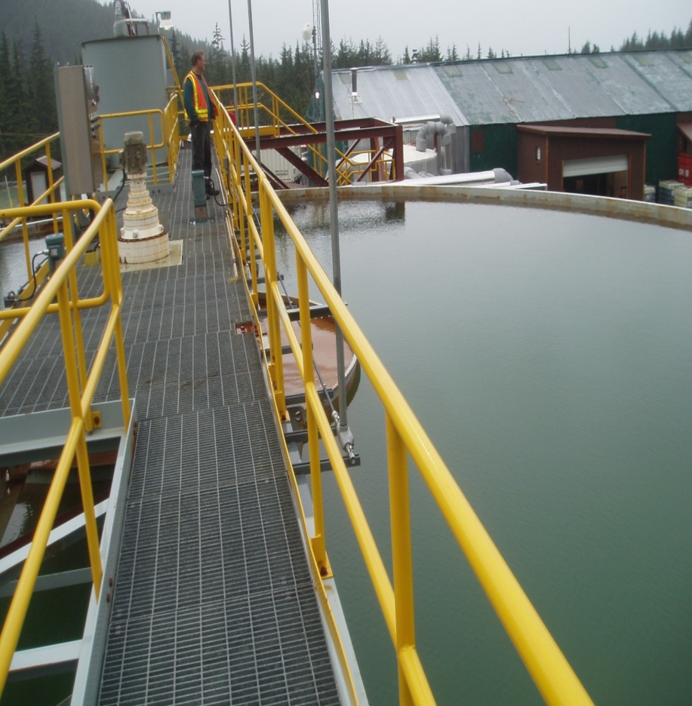
Clarification (Physical)
Clarifier at Kensington Mine
Clarifier Centerwell at Central Treatment Plant (Kellogg, ID)

Slide 8
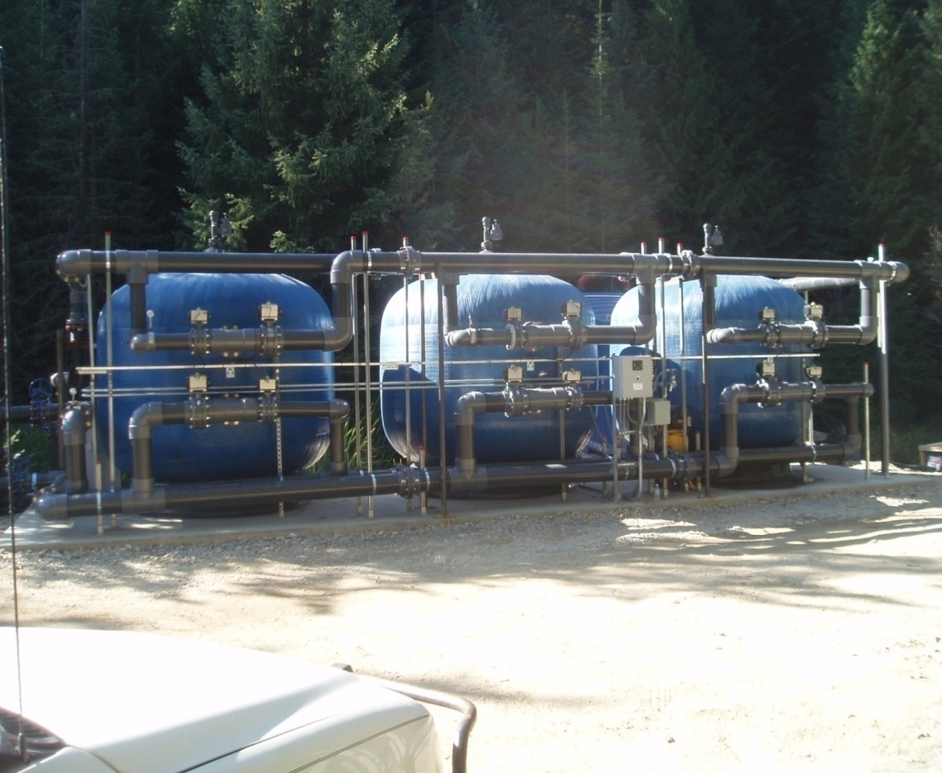
Multimedia Filtration (Physical)
No. 1 Anthracite Coal
Flint Sand
Fine Garnet
Support Gravel
1000-gpm multimedia system at Lucky Friday Mine (Mullan, ID)

Slide 9
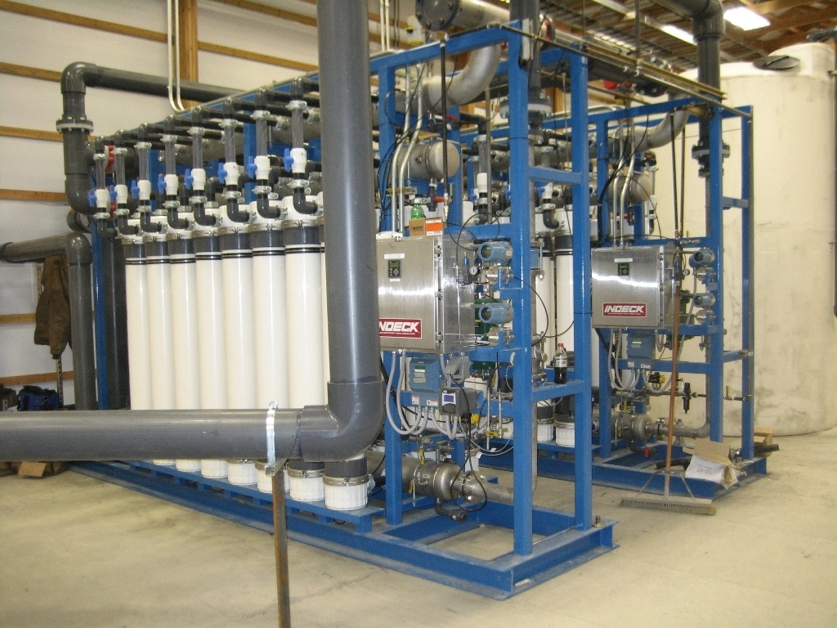
Ultrafiltration (Physical)
500-gpm UF system at Montanore Mine (Libby, MT)

Slide 10
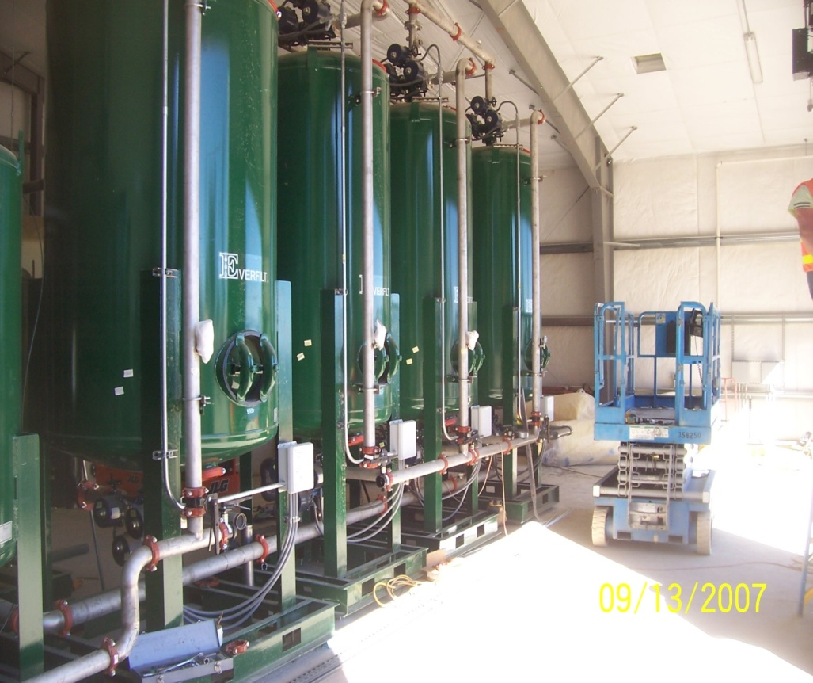
Ion Exchange (Chemical)
WATER W/ CaCl₂, NaHCO₃, MgSO₄
RESIN IN THE Ca⁺² FORM
RESIN IN THE Mg⁺² FORM
RESIN IN THE Na⁺ FORM
IX vessels at Buckhorn Mountain
WATER W/ NaCl, NaHCO₃, Na₂SO₄

Slide 11
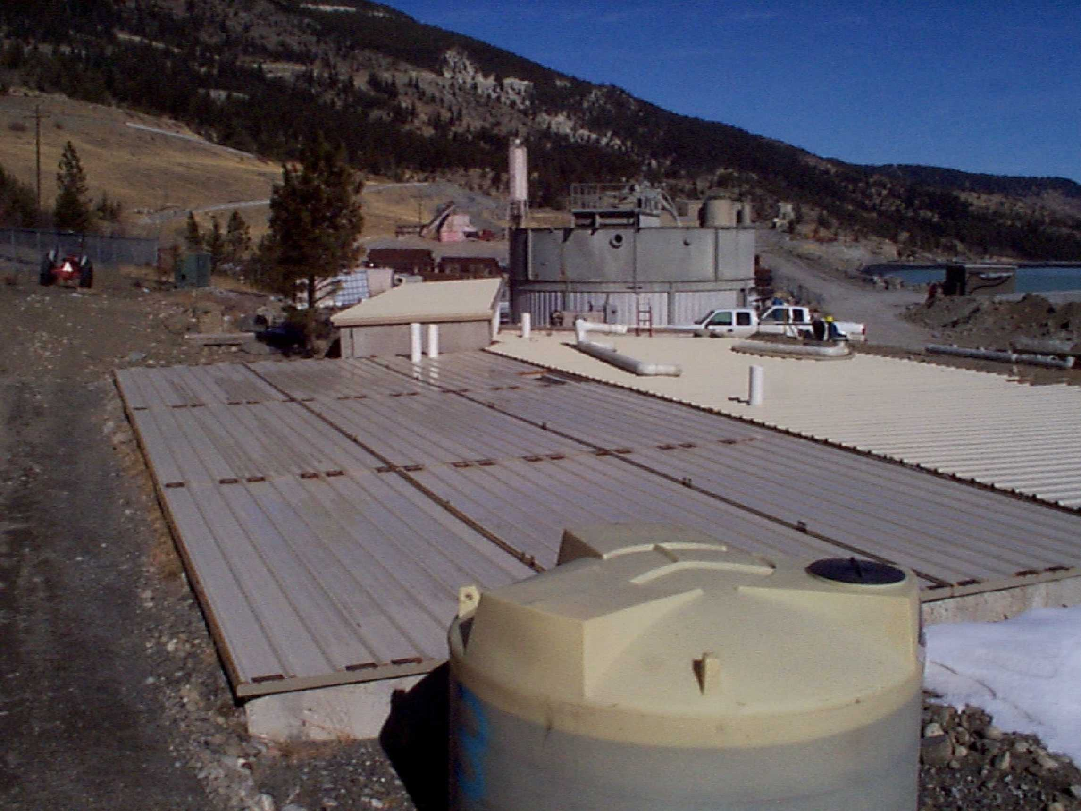
Attached Growth (Biological)
Biological treatment system at Key Mine (Republic, WA)
Biological nitrate removal system at Stillwater Mine (Nye, MT)

Slide 12
Bench/Pilot Testing
Will determine whether selected technology can meet discharge limits
Can provide valuable information for full-scale capital and operating costs
May be required by agencies
Bench testing is simpler, shorter and less expensive than pilot testing
Jar tests or column tests?

Slide 13
Bench Testing Options
Possible Jar Test | Possible Column Tests
Chemical Precipitation | Leach Testing for Nitrate/Ammonia
Coagulation/Flocculation | Ion Exchange (IX)
Ion Exchange (IX) | Biological

Slide 14
Common Pollutants and Recommended Treatment Technology
Pollutants | Treatment Technology | Location
Arsenic | Coagulation/Filtration (CF), Adsorption, IX, Reverse Osmosis (RO) | Jerritt Canyon Mine and many others
Antimony | Coagulation/Filtration, Adsorption, RO | Jerritt Canyon Mine and others
Nitrate | Biological Treatment | Key Mine, Stillwater and many others
Sulfate | Biological Treatment, Nanofiltration, Chemical Precipitation (Lime and Barium Carbonate) | Jerritt Canyon Mine, Key Mine, Kinross Underdrain and others

Slide 15
Arsenic and Antimony
EPA Maximum Contaminant Level (MCL):
Arsenic (As) – 10 ppb (0.010 mg/L)
Antimony (Sb) – 6 ppb (0.006 mg/L)
Both contaminants exist in two forms:
Trivalent (III)
Pentavalent (V)
Toxicities of As (better-known metalloid relative) and Sb are similar

Slide 16
Representative Water Quality
 |  | Concentration (mg/L)
Category | Parameter | July 2013 | 4/2/14 | 5/6/14
Common ions | pH | 7.6 | 7.6 | 7.8
 | Ca | 140 | 94 | 72
 | Na | 12 | 13 | 18
 | Mg | 78 | 64 | 47
 | F | <1.0 | <1.0 | <1.0
 | Cl | <25 | <25 | <25
 | SO₄ | 490 | 190 | 300
 | alkalinity | 220 | 130 | 180
 | TDS | 880 | 760 | 610
Metals | As | 0.230 | 0.120 | 0.094
 | Ba | 0.027 | 0.031 | 0.051
 | Cd | <0.002 | <0.002 | <0.002
 | Cu | <0.02 | 0.061 | <0.02
 | Fe | <0.3 | <0.3 | <0.3
 | Mn | 0.017 | 0.013 | 0.012
 | Pb | 0.005 | <0.005 | <0.005
 | Sb | 0.120 | 0.051 | 0.036
 | Se | <0.005 | <0.005 | <0.005
 | Tl | 0.0021 | 0.0028 | 0.0019
 | Zn | 0.14 | 0.12 | <0.10

Slide 17
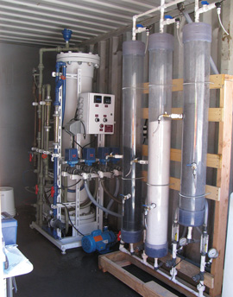
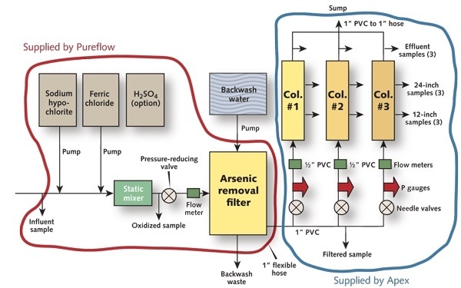
Jerritt Canyon Pilot
Six-inch columns with clear PVC enable evaluation of several types of adsorptive media in parallel

Slide 18
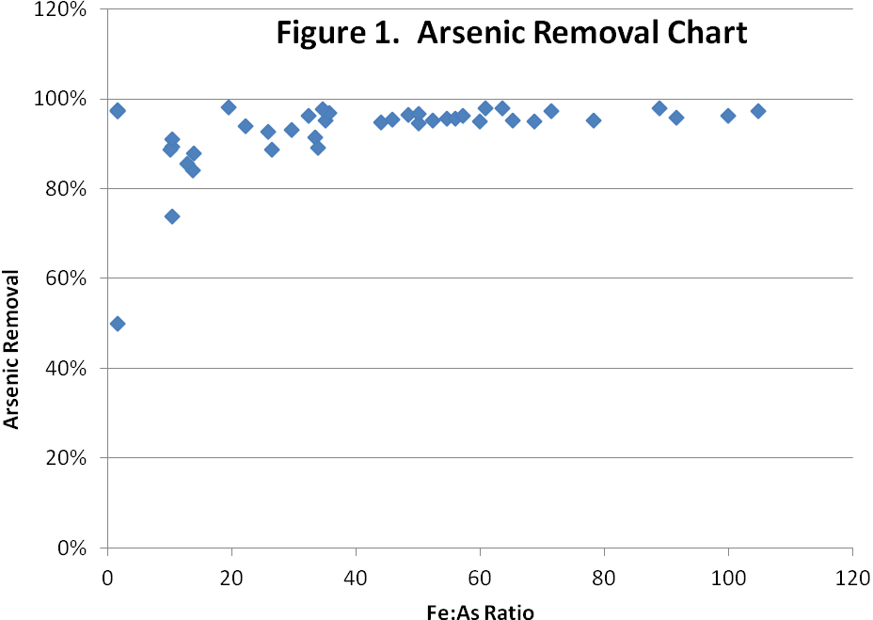
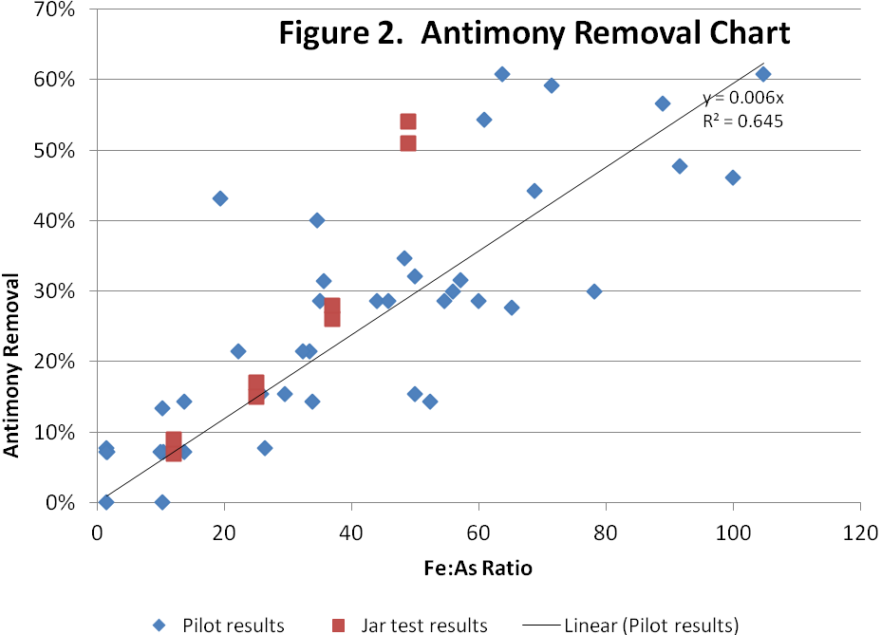
Jerritt Canyon CF Results

Slide 19
Jerritt Canyon CF Data
Overlaid Contour Plot of Antimony and Iron as a function of pH and Iron Dose

Slide 20
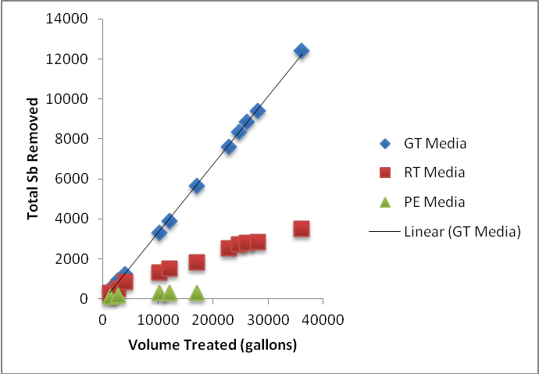
Jerritt Canyon Adsorption Results

Slide 21
Jerritt Canyon RO Results
Parameter | Feed | Permeate | Rejection
Na | 18 | 1.9 | 89%
Mg | 47 | 2.9 | 94%
K | 2.2 | 0.25 | 89%
Ca | 72 | 4.3 | 94%
Mn | 0.012 | 0.0025 | 79%
As | 0.094 | 0.0064 | 93%
Sb | 0.036 | 0.0015 | 96%
Ba | 0.051 | 0.0065 | 87%
Tl | 0.0019 | 0.0005 | 74%
SO₄ | 300 | 31 | 90%
TDS | 610 | 36 | 94%

Slide 22
Arsenic/Antimony Summary
All four technologies evaluated (CF, DAF, AM, RO) were successful
High concentrations of As and Sb
For these high concentrations, CF followed by AM polishing was most economical

Slide 23
Nitrate Treatment: Key Mine

Slide 24
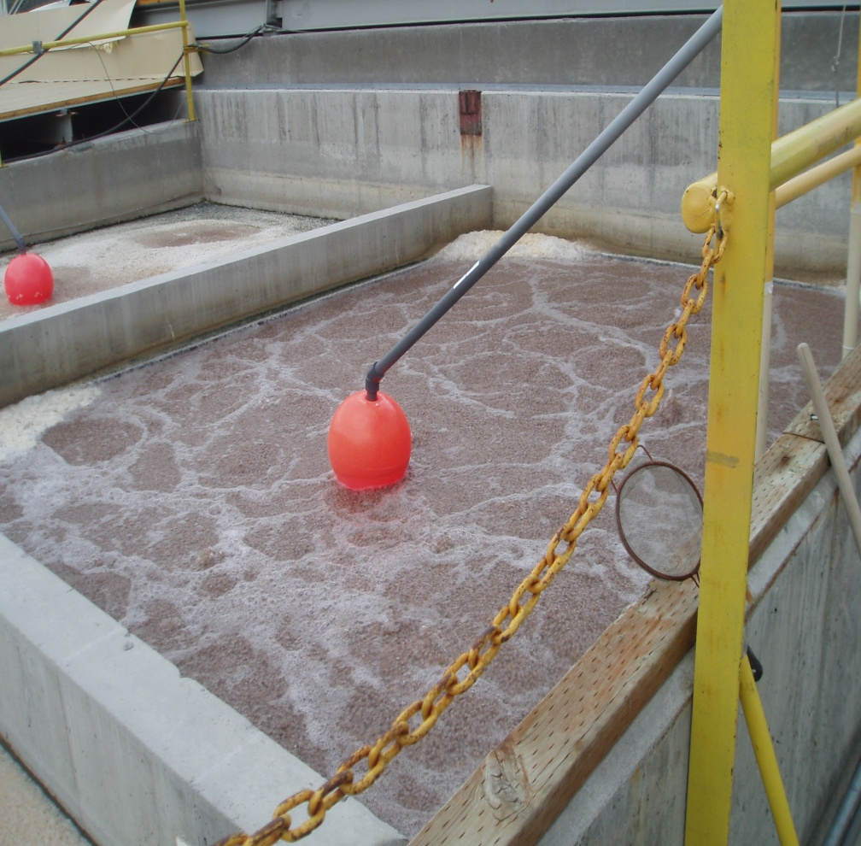
Nitrate Treatment: Stillwater East Boulder
Anox Kaldnes system
Installed in 2006
100 gpm
Designed to remove 22 lb/day NH₄ and 55 lbs/day NO₃-N
Methanol feed

Slide 25
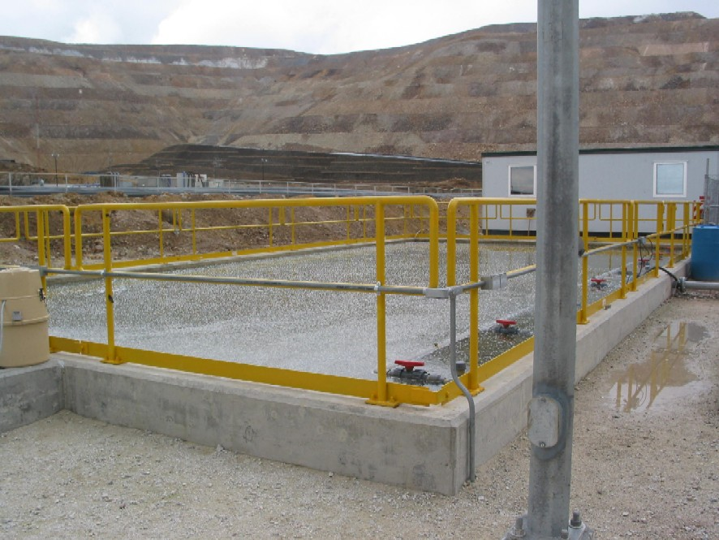
Nitrate Treatment: Minera Yanacocha
Design flow of 50 m³/hr (220 gpm)
Reduced [NO₃-N] from 35 to 10 mg/L (45 kg/day)
Methanol feed
Effective but client implemented RO

Slide 26
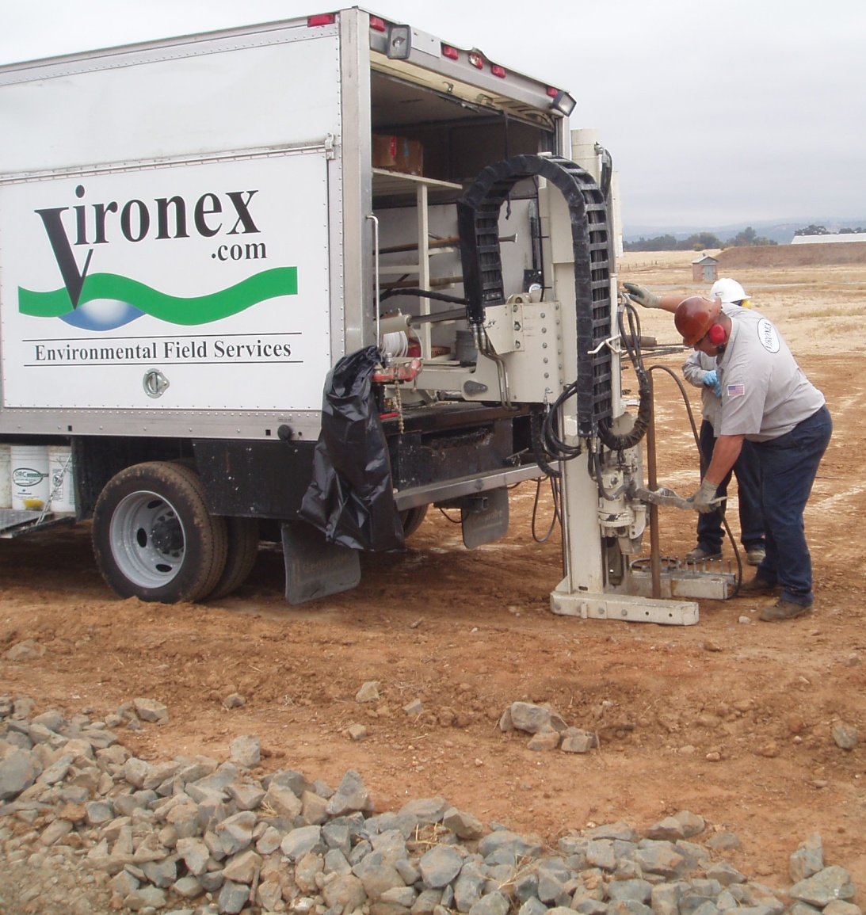
Nitrate Treatment: Alpha Explosives
In situ treatment for NO₃ and ClO₄
Acetate injection
Removal of 48% and 75% of nitrate in two source areas to date
[NO₃-N] up to 1400 mg/L

Slide 27
Sulfate Treatment: Key Mine

Slide 28
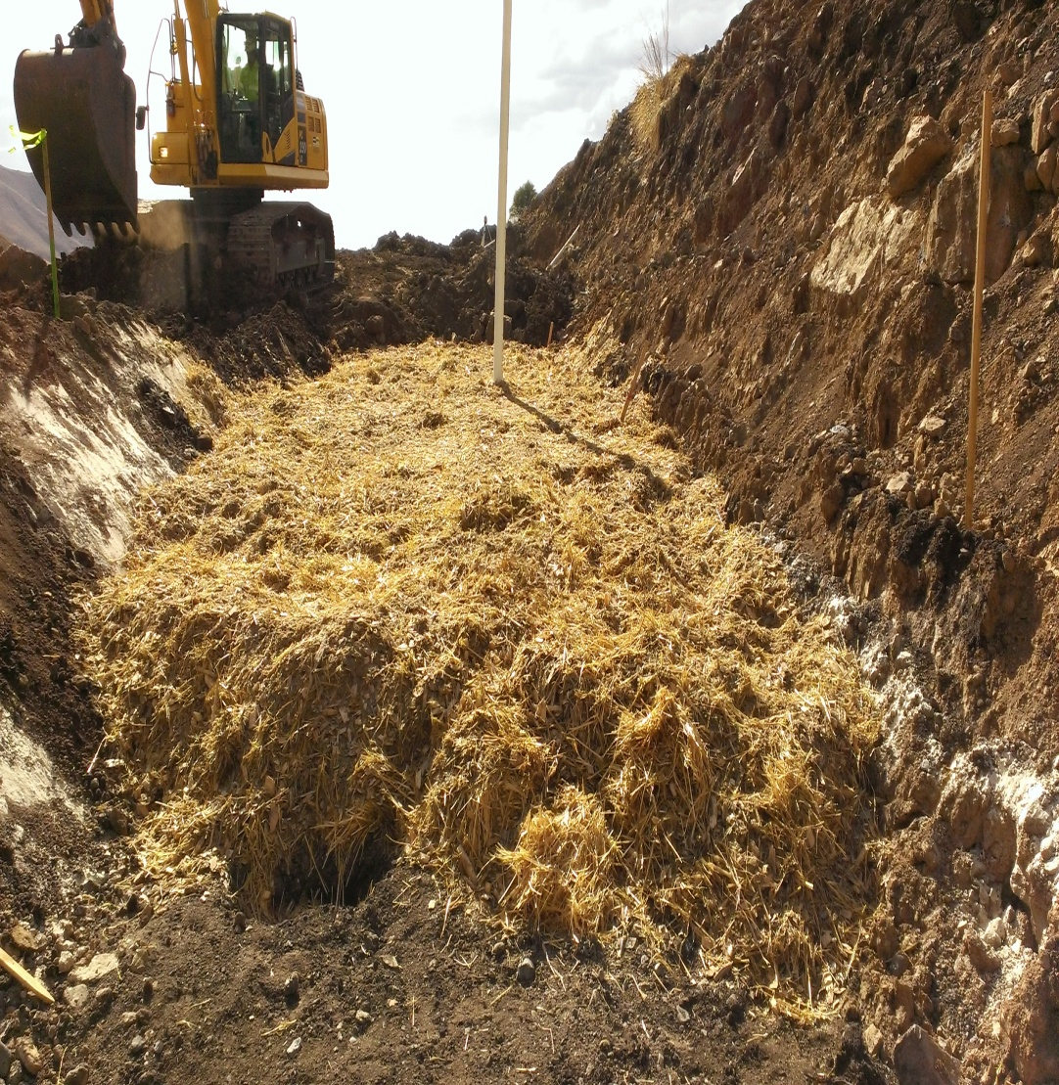
Sulfate Treatment: Jerritt Canyon
One system so far (Marlboro Canyon)
Two more planned
Flow = 10 gpm
1000 ft long
Wood chips, sawdust, straw, limestone, manure
[SO4]: 2800 → < 250

Slide 29
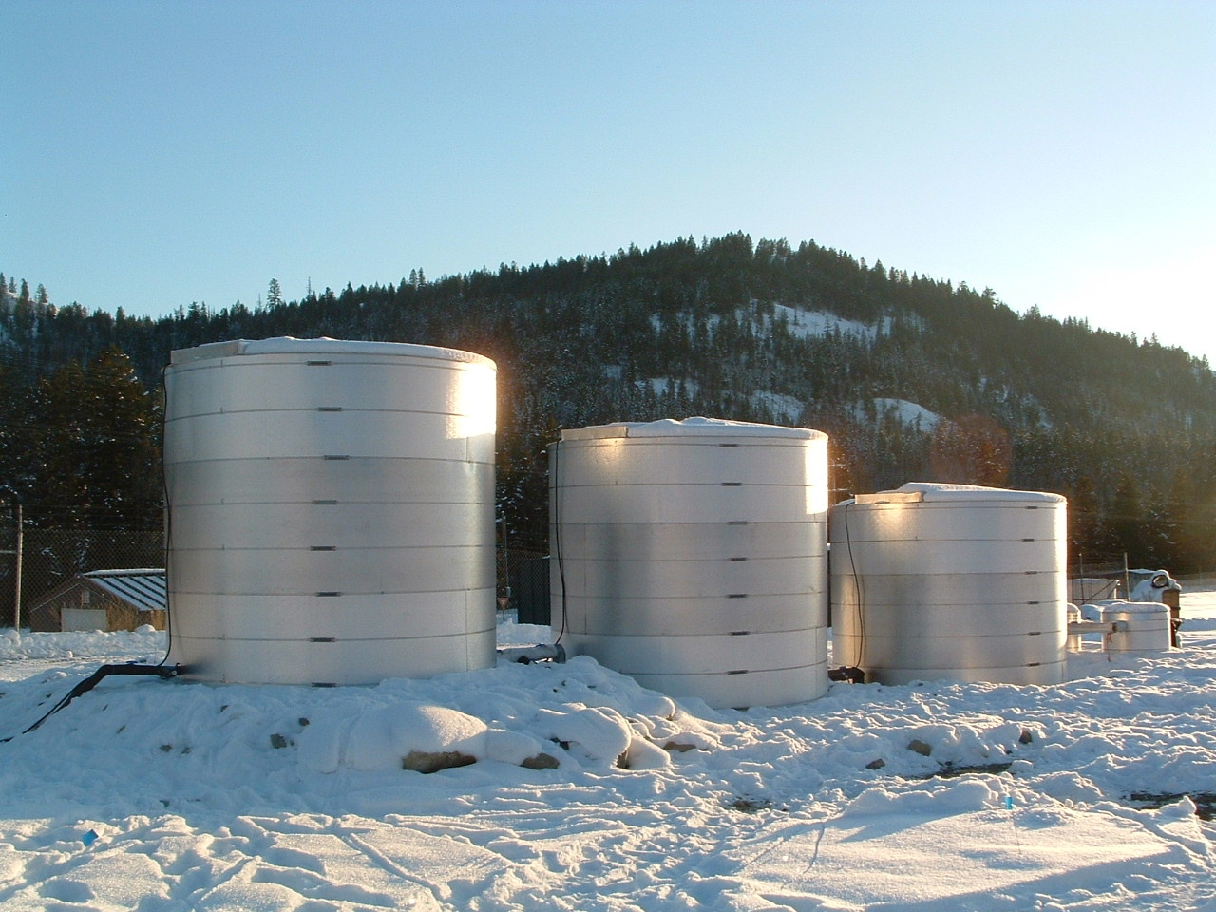
Sulfate Treatment: Kinross Underdrain
Removal of SO₄ and NO₃
Initial [SO₄] = 100-120 mg/L
Final [SO₄] as low as 20 mg/L
Methanol and phosphate feed

Slide 30
Sulfate Treatment: PolyMet Mining
In situ system (10 gpm) for pit lake in Northern Minnesota
Uses plastic media for biofilm growth
1200 mg/L SO₄
Treatment goal is < 10 mg/L
Achieving 100-200 mg/L so far
Ethanol, nitrate and phosphate feed

Slide 31
Recommendations
Arsenic
Iron addition/filtration, Ti adsorption, iron adsorption or IX
Nitrate
Denitrification (attached growth) in almost all cases
Sulfate
Biological (attached growth) or NF
Dissolved metals
Hydroxide ppt. or sulfide ppt. or IX
Ammonia
Nitrification, zeolites or breakpoint chlorination

Slide 32
For More Information
On Apex Website:
Technology reviews for nitrate, arsenic, sulfate removal
Natural zeolites: thallium, ammonia
Floating islands
In situ treatment
Summary of Treatment Technologies for Mining-Influenced Water (EPA, 2014)

Slide 33
Questions?
Mark Reinsel
mark@apexengineering.us
406-459-2776
http://apexengineering.us
Gideon Sarpong
775-299-9628
maxi@mailpuppy.com

